Slide 1

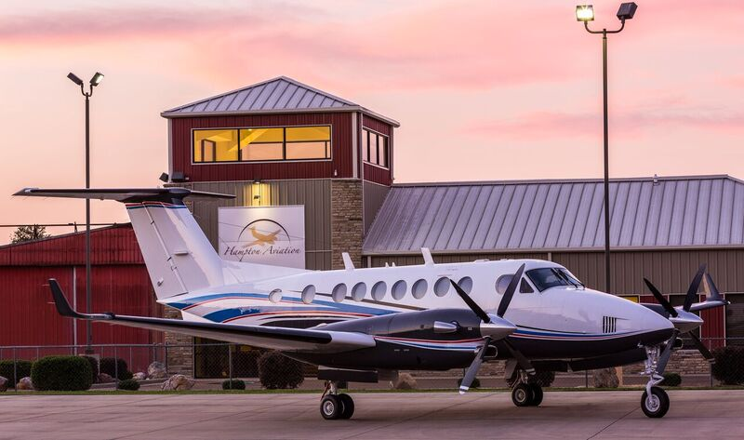
196 Highway 980
Mena, Arkansas 71953
(479) 394-5290
A Company dedicated to quality, integrity and our customers.

Slide 2

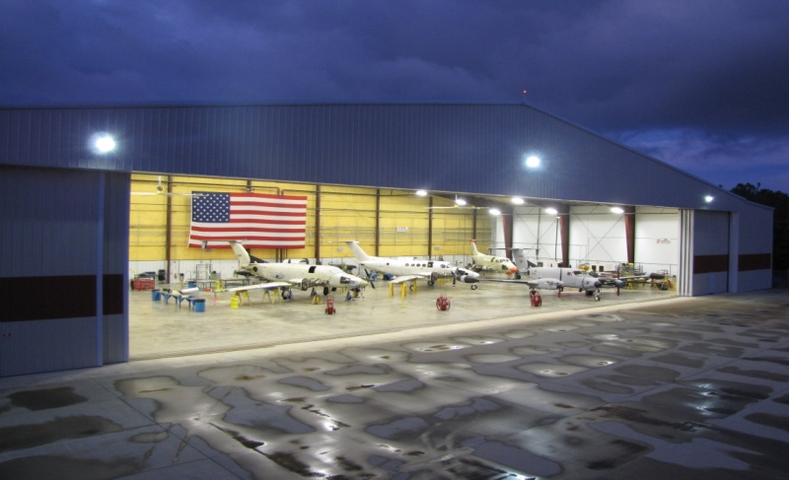
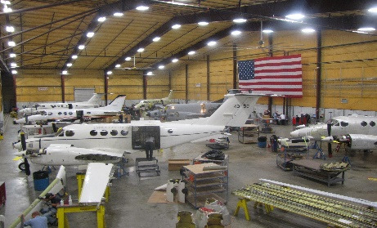
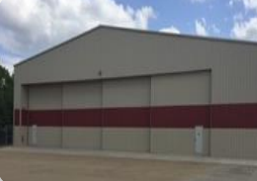
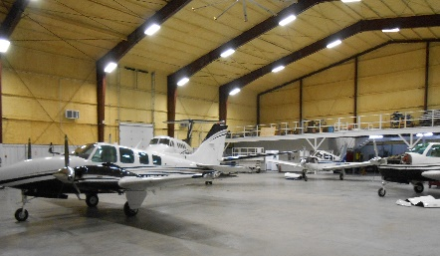
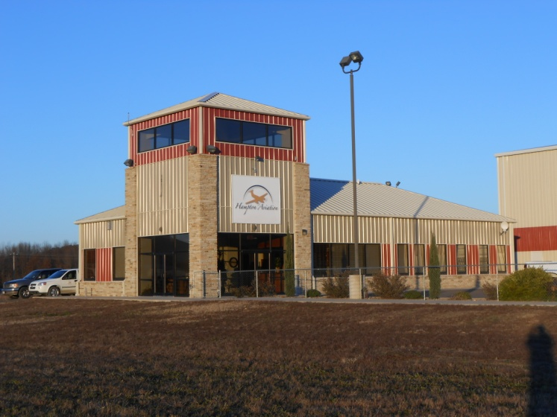
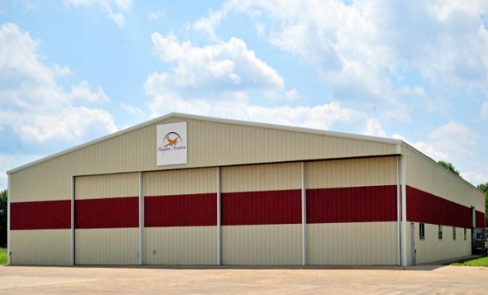
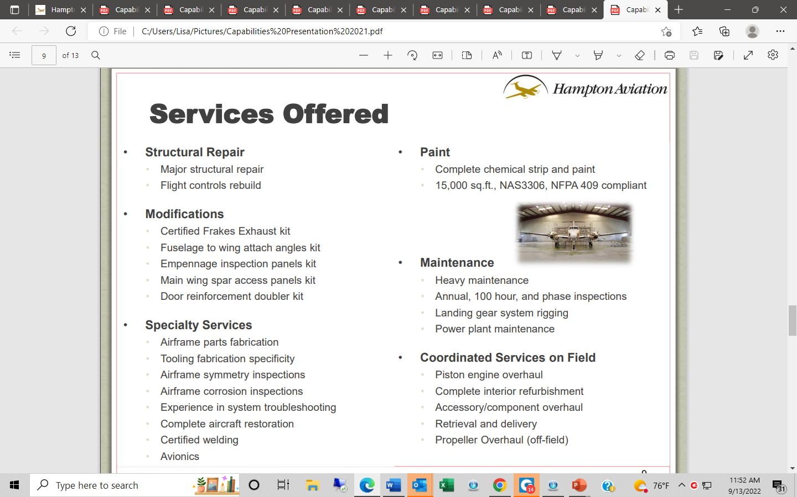
Hampton Aviation Facilities
Military Hangar
25,000 sq. ft.
General Aviation Hangar
13,750 sq. ft.
Paint Hangar
15,000 sq. ft.
Corporate Office

Slide 3
Points of Contact
Larry Davis, President (479) 394-5290
Acting as:
Director of Maintenance (DOM)
Director of Operations
Contractor’s Requesting Official (CRO)
Peter Herr, Director & Avionics Manager (QAM) (479) 394-5290
Acting as:
Quality Assurance Manager
Chief Inspector
Aviation Safety Official (ASO)
David Phelps, Maintenance Manager (479) 394-5290
Acting as:
Maintenance Manager
Greg Davis, Assistant Maintenance Manager (479) 394-5290
Acting as:
Assistant Maintenance Manager
Bill Dunlap, Parts & Logistics Manager (479) 394-5290
Acting as:
Parts/Tool Room Manager
Cedrick Stampley, FOD & Safety Manager (479) 394-5290
Acting as:
FOD & Safety Manager
Phyllis Caldwell, Office Manager (479) 394-5290

Slide 4
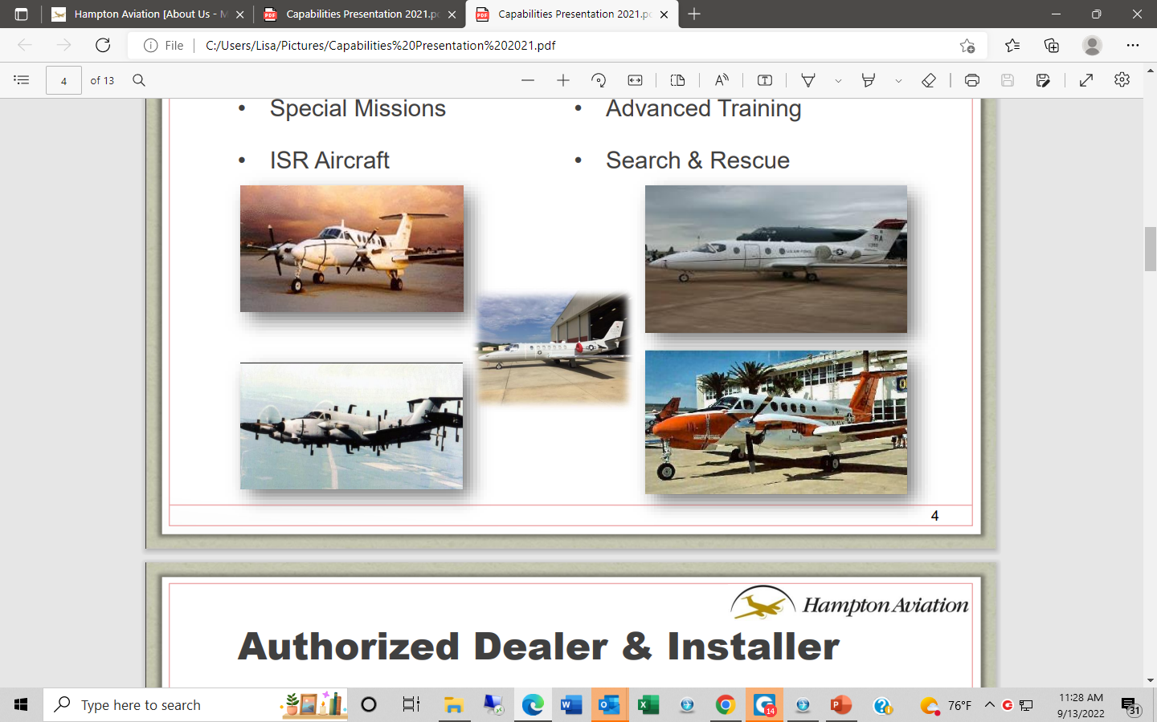
Reliable Support for Special Mission Aircraft Across the Armed Forces
Special Missions
ISR Aircraft
Advanced Training
Search & Rescue

Slide 5
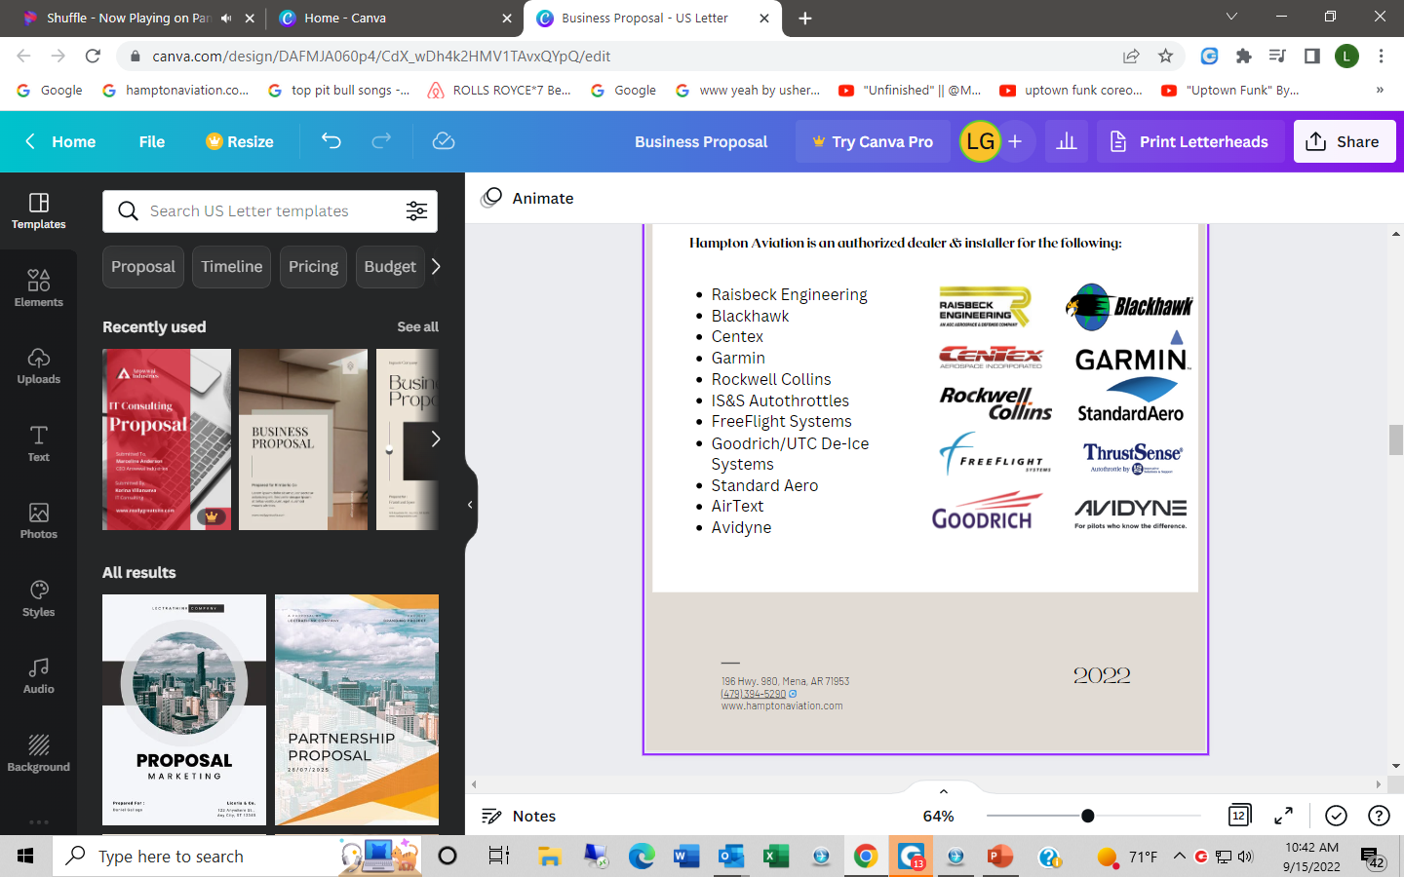
Authorized Dealer & Installer
HAWCS is an authorized dealer & installer for the following:

Slide 6
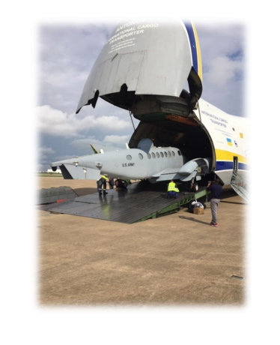
Our Experience & Core Competencies
Special Mission Program Start-up
Structural Modifications and Upgrades
Structural Component Change
Inspections and NDT
Full Strip and Paint
Interior Refurbishment
Maintenance Test Flights
Damaged Aircraft Retrieval
Damage Assessment and Consulting
Global On-site Support
Certified Welding
Avionics

Slide 7
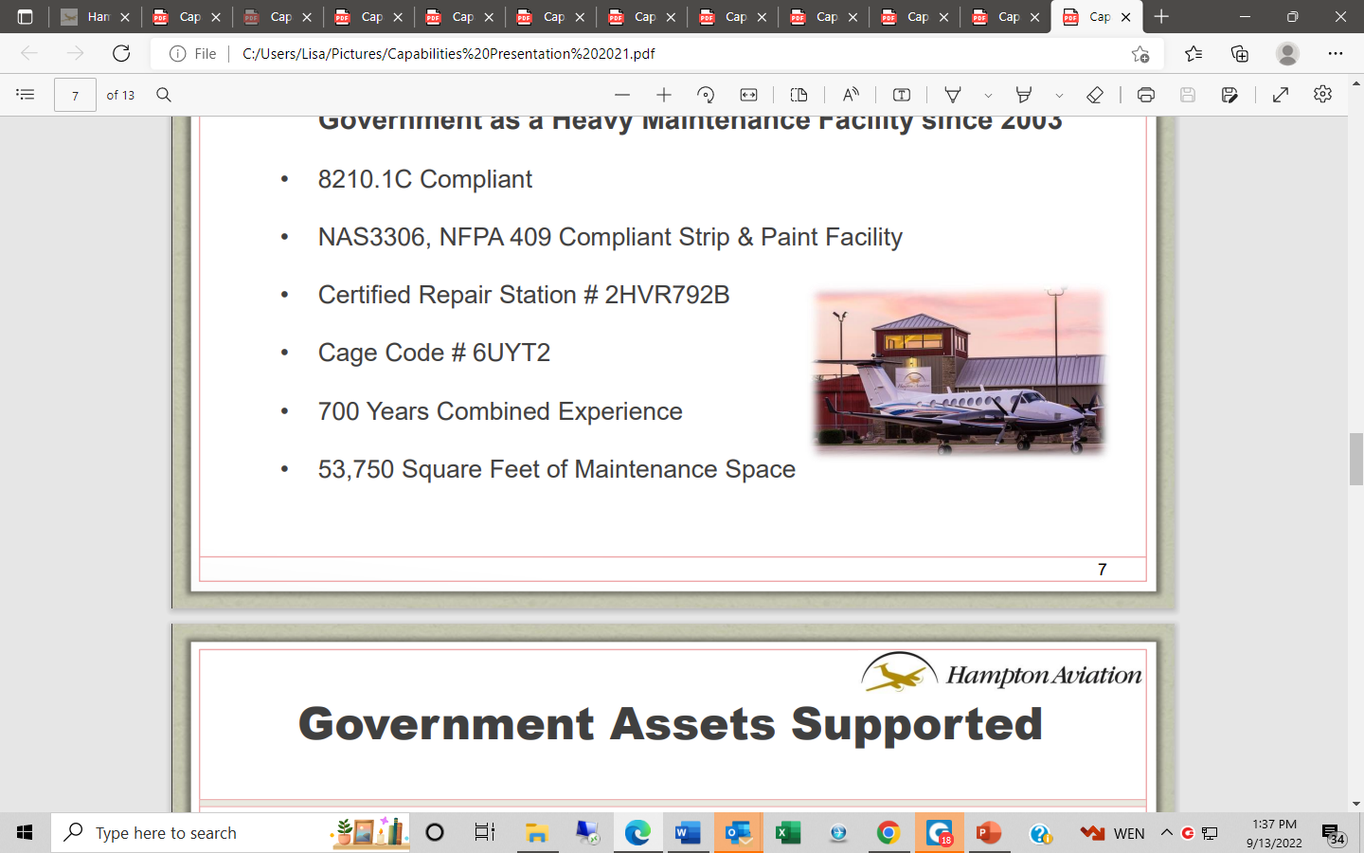
Our Qualifications
Hampton Aviation has been serving Prime Contractors and the
US Government as a Heavy Maintenance Facility Since 2003
8210.1C Compliant
NAS3306, NFPA 409 Compliant Strip & Paint Facility
Certified Repair Station # 2HVR792B
Cage Code # 6UYT2
700 Years Combined Experience
53,750 Square Feet of Maintenance Space

Slide 8
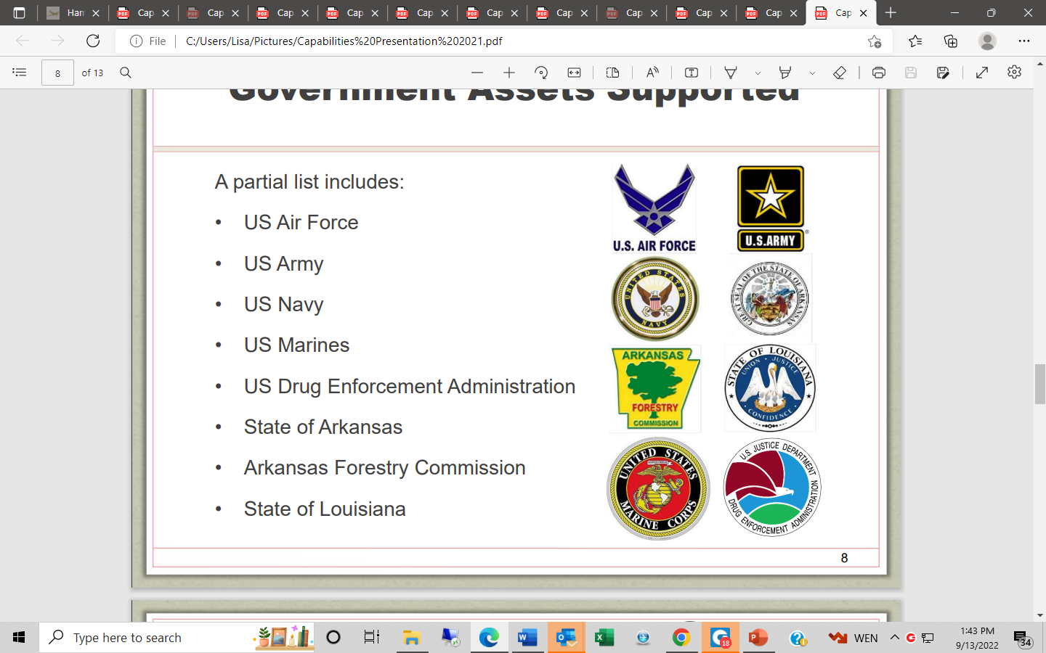
Government Assets Supported
A partial list includes:
US Air Force
US Army
US Navy
US Marines
US Drug Enforcement Administration
State of Arkansas
Arkansas Forestry Commission
State of Louisiana

Slide 9
Services Offered
Structural Repair
  Major structural repair
  Flight controls rebuild
Modifications
  Certified Frakes Exhaust kit
  Fuselage to wing attach angles kit
  Empennage inspection panels kit
  Main wing spar access panels kit
  Door reinforcement doubler kit
Specialty Services
  Airframe parts fabrication
  Tooling fabrication specificity
  Airframe symmetry inspections
  Airframe corrosion inspections
  Experience in system troubleshooting
  Complete aircraft restoration
  Certified welding
  Avionics
Paint
  Complete chemical strip and paint
  15,000 sq. ft., NAS3306, NFPA 409 compliant
Maintenance
  Heavy maintenance
  Annual, 100 hour, and phase inspections
  Landing gear system rigging
  Power plant maintenance
Coordinated Services on Field
  Piston engine overhaul
  Complete interior refurbishment
  Accessory/component overhaul
  Retrieval and delivery
  Propeller overhaul (off-field)

Slide 10
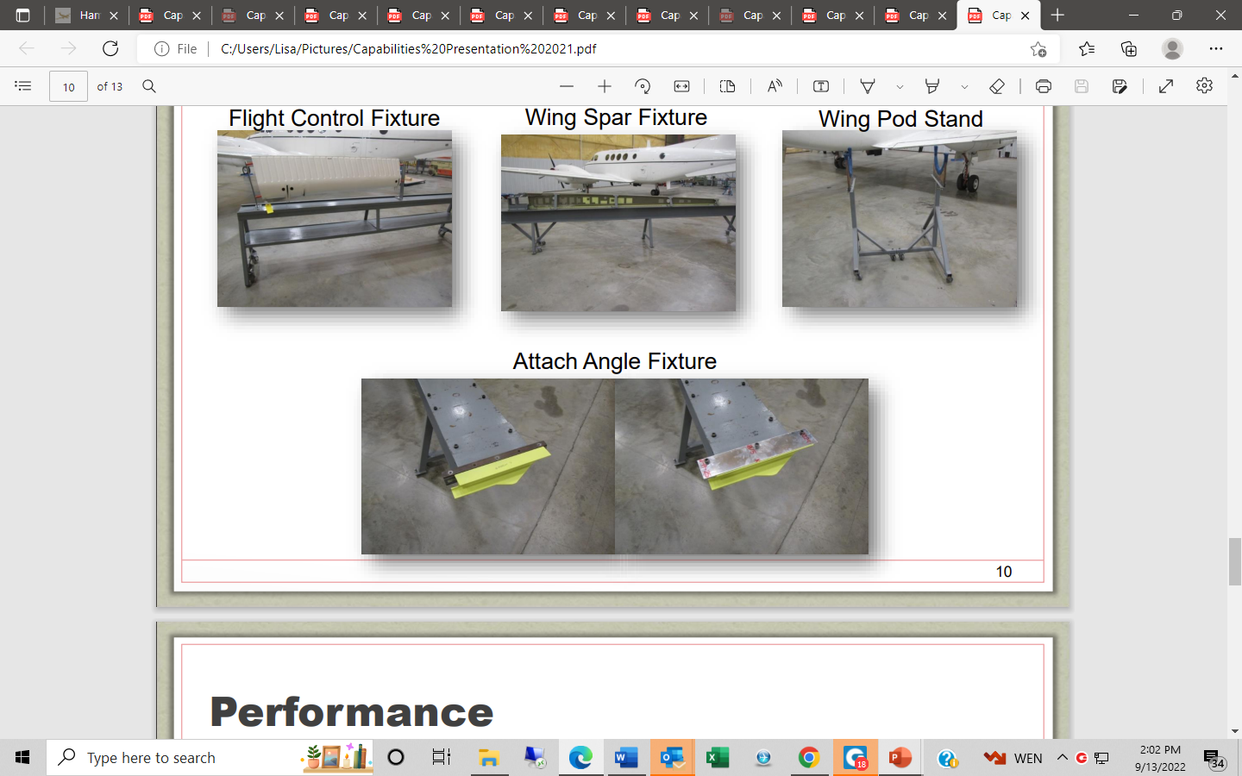
Tool Design and Development Capabilities

Slide 11
Performance
Hampton Aviation has been serving Prime Contractors supporting the US Government as a Heavy Maintenance Facility since 2003. Hampton Aviation expanded their work force, added a new 25,000 sq. ft. maintenance hangar and a new state of the art paint Facility to support the Army, Air Force & Navy.
L-3 Communications
2012 - Present
235 Aircraft
35+ global support missions
Northrop Grumman
2018 – Present
23 Aircraft
DynCorp
2003 – 2011
96 Aircraft

Slide 12
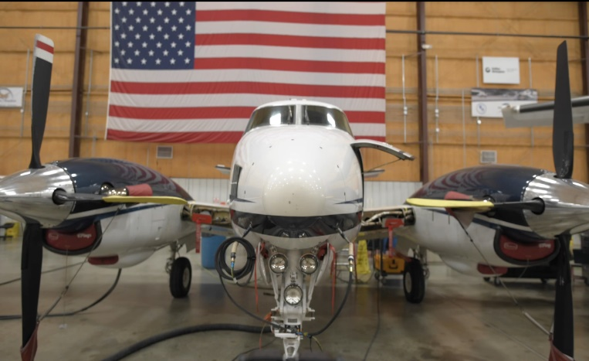
Our Promise
Hampton Aviation specializes in heavy structural repair, maintenance, and modifications on any aircraft from piston singles to cabin class turbines.
With our proven combination of quality, cost effectiveness, and turn around time, we can confidently say that Hampton Aviation is unlike any other repair facility in the industry.
Our promise is to return your aircraft in better condition than it was before the need for service.

